Slide 1
词性标注 和 汉语分词
POS tagging and Chinese word segmentation

Slide 2
Outline
HMM POS tagging
Chinese word segmentation 汉语分词
Unknown word recognition未登录词识别
Other POS tagging methods 其他的词性标注方法

Slide 3
Pos tagging 词性标注
Problem description: given a sentence of symbols, determine the most plausible tag for each symbol 问题描述：给定一个符号串，每个符号是某个类的集合中的一类，确定最可能的类别串。
Problem Class 同类问题：
  Pinyin input method 拼音汉字转换
  Speech Recognition 语音识别
  Pronunciation Tagging 汉字注音

Slide 4
What is POS tagging good for?
Speech synthesis:
  How to pronounce “lead”?
  INsult inSULT
  OBject obJECT
  OVERflow overFLOW
  DIScount disCOUNT
  CONtent conTENT
Stemming for information retrieval
  Knowing a word is a N tells you it gets plurals
  Can search for “aardvarks” get “aardvark”
A subproblem which can make parsing easier

Slide 5
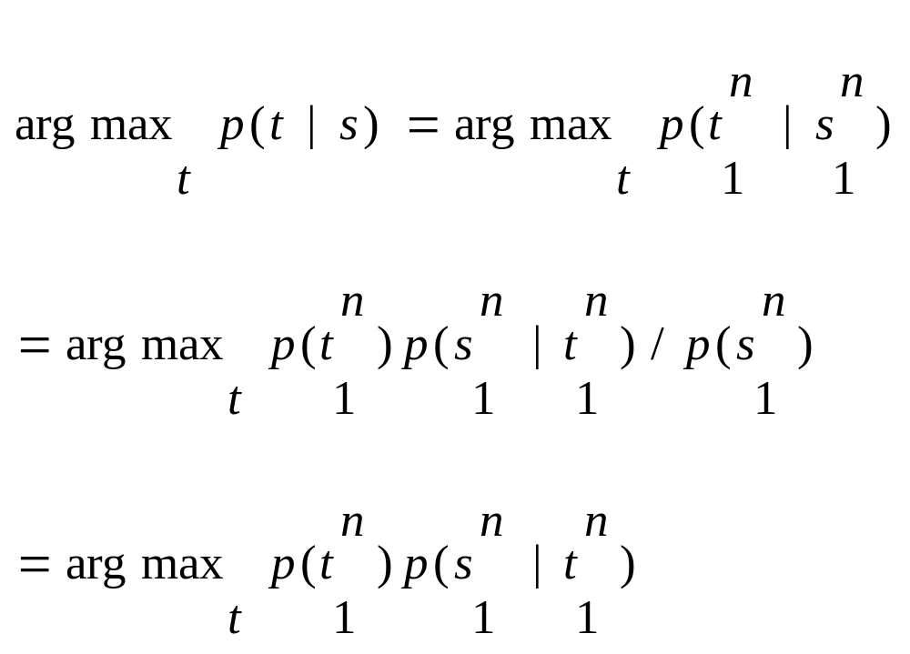
Best possible tags
找出最好的标注串
The tagger finds the most probable tag sequence (t) given the sentence (s)

Slide 6
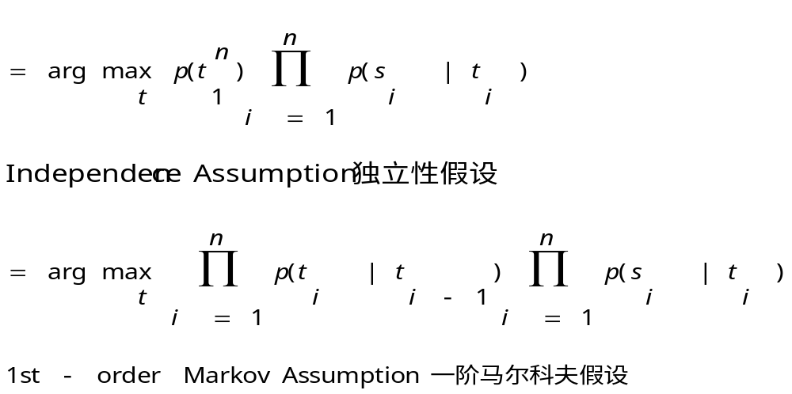

Slide 7
HMM Model
The classic HMM model uses 1st-order Markov model. However, we can use 2nd order Markov model；可以采用二阶马尔可夫假设，这就不是经典的HMM模型
When HMM is used for POS tagging, the states are tags and observations are words. HMM模型来做词性标注，状态就是词性,观察值是单词. P(t_{i}|t_{i-1}): transition probability 称为词性转移概率， P(s_{i}|t_{i}) observation probability 称为单词生成概率

Slide 8
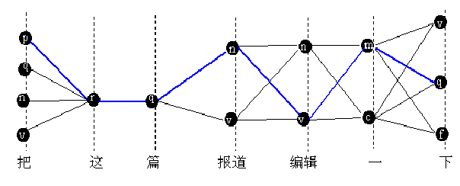
The blue path is Viterbi path
蓝色的是最优路径

Slide 9
DP/ Viterbi for POS tagging
动态规划算法求解
最大概率问题转化为最短路径问题（取对数，负之）
需要知道P(ti|ti-1), P(si|ti)。We can estimate these probabilities from corpus 如果有已经标注好的语料库，可以从中估计
We need to add <s> and </s> before and after a sentence to make probabilities tighter，使概率计算更精确

Slide 10
POS tagging: a short history
1960-70，Brown corpus，87 tags: rule-based tagging: ~85%
1988, Ken Church, DP, 95%
~1990，HMM tagger
1996, Maximum entropy tagger
~2001, conditional random field tagger

Slide 11
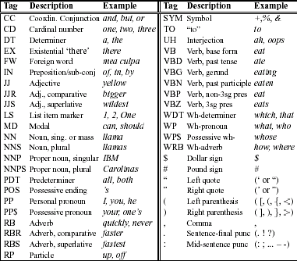
Penn tagset

Slide 12
How hard is POS tagging? Measuring ambiguity
Unambiguous (1 tag): 35,340
Ambiguous (2-7 tags): 4,100
2 tags | 3,760
3 tags | 264
4 tags | 61
5 tags | 12
6 tags | 2
7 tags | 1(still)
(Derose, 1988)

Slide 13
Evaluation 词性标注的评价
precision：Correct tags/generated tags
recall：Correct tags/gold standard tags
F-measure: 2*precision*recall/(precision+recall)
HMM: ~97%

Slide 14
Comments
Can we achieve 100% accuracy?
Upper bound: human accuracy? Statistical methods normally cannot surpass human.
  But AlphaGo have defeated the Human in hardest Game Go!
Baseline: simply choosing the most probable tag can have an accuracy of 90%. 比如，就词性标注而言，选择最可能的词性，就能达到90%准确率，这就是下限，不能比这还差！

Slide 15
Chinese word segmentation and POS tagging 汉语的分词标注
First word segmentation, then tagging 可以先分词，后标注
word segmentation and tagging done simultaneously 分词和标注也可以一起进行：这样做的好处是错误不会传播. 联合优化!
All possibilities of segmentation are considered 计算概率时允许所有可能的切分方式

Slide 16
Word lattice 词图
Trellis in HMM becomes lattice 隐马模型的格变成了“词图”
画：“结合成分子”的词图
结 合 成 分 子

Slide 17
词图
When drawing the lattice, all words are considered, including OOV 画词图时，找出所有可能的词,包括未登录词
DP algorithms still apply 动态规划算法仍然适用
Segtag demo 演示

Slide 18
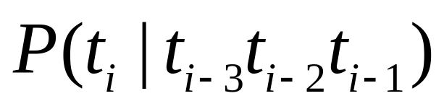
Extending the classical HMM in POS tagging
Use nth order Markov property. Use n-gram POS tags for states. n阶马尔可夫假设.状态是n元标记串.
  E.g. For 2nd order Markov models, states are POS bigrams. 对2阶马尔可夫假设的情形, 以标记的Bigram为状态
  But normally 4-grams are more than enough. 但是一般最多到4元.

Slide 19
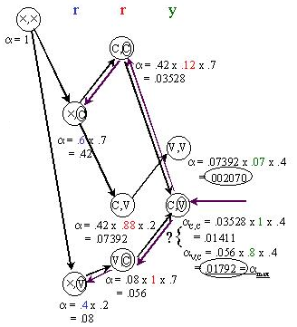
N-best计算
保留n个最佳结果，而不是1个
最优解：VCV；次优解：CCV

Slide 20
N-Best结果
p
n
a
n
n
-1 | 6.98
c
v
d
v
v

Slide 21
p
00 | 14.62
n
a
n
n
-1 | 6.98
c
00 | 12.28
v
d
v
v
00 | 18.22

Slide 22
p
00 | 14.62
n
10 | 19.87
00 | 21.65
20 | 25.89
a
n
n
-1 | 6.98
c
00 | 12.28
v
d
v
v
00 | 18.22

Slide 23
p
00 | 14.62
n
10 | 19.87
00 | 21.65
20 | 25.89
a
n
n
-1 | 6.98
c
00 | 12.28
v
10 | 20.86
00 | 23.9
20 | 27.61
d
v
v
00 | 18.22

Slide 24
p
00 | 14.62
n
10 | 19.87
00 | 21.65
20 | 25.89
a
00 | 32.42
01 | 34.2
10 | 36.16
n
n
-1 | 6.98
c
00 | 12.28
v
10 | 20.86
00 | 23.9
20 | 27.61
d
v
v
00 | 18.22

Slide 25
p
00 | 14.62
n
10 | 19.87
00 | 21.65
20 | 25.89
a
00 | 32.42
01 | 34.2
10 | 36.16
n
n
-1 | 6.98
c
00 | 12.28
v
10 | 20.86
00 | 23.9
20 | 27.61
d
00 | 29.38
01 | 31.16
10 | 31.38
v
v
00 | 18.22

Slide 26
p
00 | 14.62
n
10 | 19.87
00 | 21.65
20 | 25.89
a
00 | 32.42
01 | 34.2
10 | 36.16
n
10 | 44.59
00 | 44.88
11 | 46.37
n
-1 | 6.98
c
00 | 12.28
v
10 | 20.86
00 | 23.9
20 | 27.61
d
00 | 29.38
01 | 31.16
10 | 31.38
v
10 | 37.47
11 | 39.25
12 | 39.47
v
00 | 18.22

Slide 27
p
00 | 14.62
n
10 | 19.87
00 | 21.65
20 | 25.89
a
00 | 32.42
01 | 34.2
10 | 36.16
n
10 | 44.59
00 | 44.88
11 | 46.37
n
-1 | 6.98
c
00 | 12.28
v
10 | 20.86
00 | 23.9
20 | 27.61
d
00 | 29.38
01 | 31.16
10 | 31.38
v
10 | 37.47
11 | 39.25
12 | 39.47
v
00 | 18.22

Slide 28
p
00 | 14.62
n
10 | 19.87
00 | 21.65
20 | 25.89
a
00 | 32.42
01 | 34.2
10 | 36.16
n
10 | 44.59
00 | 44.88
11 | 46.37
n
-1 | 6.98
c
00 | 12.28
v
10 | 20.86
00 | 23.9
20 | 27.61
d
00 | 29.38
01 | 31.16
10 | 31.38
v
10 | 37.47
11 | 39.25
12 | 39.47
v
00 | 18.22

Slide 29
p
00 | 14.62
n
10 | 19.87
00 | 21.65
20 | 25.89
a
00 | 32.42
01 | 34.2
10 | 36.16
n
10 | 44.59
00 | 44.88
11 | 46.37
n
-1 | 6.98
c
00 | 12.28
v
10 | 20.86
00 | 23.9
20 | 27.61
d
00 | 29.38
01 | 31.16
10 | 31.38
v
10 | 37.47
11 | 39.25
12 | 39.47
v
00 | 18.22

Slide 30
N-Best Search results
1)收入/n 和/c 生活/n 进一步/d 提高/v 37.47
2)收入/n 和/p 生活/n 进一步/d 提高/v 39.25
3)收入/n 和/c 生活/v 进一步/d 提高/v 39.47

Slide 31
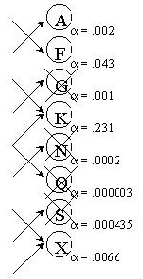
Pruning for speedup
剪枝加快速度
在每一个时刻，如果Trellis上的状态过多，怎么办？
答案是剪枝：
1、按α(与最小路径代价的比值)的阈值剪枝， α太低的路径不再继续搜索
2、按状态的数量剪枝，超过多少个状态就不再扩展了『最多保留n个状态，n<N』

Slide 32
未登录词的处理-人名识别
难点在于未登录词的生成概率估计
P（u|c） 其中 c是未登录词的类，u是未登录词
比如， P(史晓东|nr)，nr表示人名
另外，什么才叫未登录词呢？比如什么才是人名呢？这可以用规则，也可以用另外的概率模型：P(c|u)

Slide 33
以人名为例，我们需要识别可能的人名。
P(nr|史晓东) >= threshold
采用独立性假设：
P(nr|史晓东) = P(nrf|史) P(nr2|晓) P(nr3|东)
如果有一个标注语料库，可以估计P(nrf|史) ，但是我们只有一个小语料库，很多姓氏没有出现

Slide 34
解决方法
P(nrf|史)= P(史|nrf)P(nrf)/P(史)
我们有一个人名库，可以估计 P(史|nrf), 还有大规模的未标注语料库，可以估计P(史)，P(nrf)可以从小规模标注语料库估计。
但是, 可能出现 P(C|nrf)>P(C)，因为未标注语料库数据稀疏问题，所以 P(nrf|C)可能出现荒唐的>1 【这里C为某个汉字】
解决办法呢？
1）调整 P(nrf|C)，比如大于1则认为都＝1
2) 还有更好的办法吗？（思考题）

Slide 35
实验结果
因为概率估计的不准确，实际上采用P(史晓东|nr)更不准确，现在的segtag采用的是P(nr|史晓东)。但这是错误的！（参见FSNLP的HMM POS tagging有关注释！）
[ P(史晓东|nr)＝
P(nr|史晓东) P(史晓东)/P(nr)
P(史晓东)的估计也许太不准了]

Slide 36
未登录词类别
新词
Noun：斑竹、大虾、面瓜、菜鸟、美眉、陶吧、911、九一一
Verb：打的、埋单、买单
Adjective：酷、小资、爽
命名实体
时间、地名、人名、组织机构名
商标、公司名、电话号码、电子邮件地址等等
合成词，简称，派生词
话题识别与跟踪、信息抽取
三个代表、十六大
牛市、熊市
可读性、信息化

Slide 37
An Sample Text －from Li Baoli
一个11岁学生写的“字母+数字+汉字”的大杂烩日记：
“昨晚，我的JJ带着他的青蛙BF到我家来吃饭。在饭桌上，JJ的BF一个劲儿地对我妈妈PMP，说她年轻的时候一定是个漂亮MM。那酱紫真是好BT，7456……”

Slide 38
未登录词识别概论
概率方法，需要构造精确的概率模型。概率方法也要用到语言学的知识。新词需要在文本中出现一定的频率，不是任何时候都适用
规则方法和语言学的方法，可以解决概率方法的频率瓶颈。
两种方法是互补的，都要采用

Slide 39
语言学方法
筑(x) 波(n) 大學(n) 延請(v) 七三年(t) 諾貝爾(nr) 物理學(n) 獎(n) 得主(n) 江(n)
崎(x) 出任(v) 校長(n)
不能单用的字（附着词素，bound morpheme)可以触发未登录词识别
识别后的Context 必须合乎语法。
  如何判断是否合乎语法？【n元词性？句法？】
问题是：这样的单字很少。方法的有效性需要靠统计来判别！

Slide 40
概率方法
Bayes方法
互信息方法
熵的方法
条件随机场

Slide 41
Is a tagset reasonable?
词类合理吗?
词性标注问题算法主要用到了局部上下文
许多同类的词其语境很不一样，如北大原来的标注集中，代词分为一类，包括
  人称代词
  疑问代词
  指示代词
显然不合理。因此，如果代词周围的词有多个词性，显然无法利用不同代词的区别特性

Slide 42
一次试验
将原来北大的代词分成8类，重新训练，结果标注的正确率和召回率都有所提高
宋柔称属于某个类别的词，但是与该类中的大多数此相比具有特异性的词为边缘词。
类分得太细，则训练数据需求越大。
北大的词性标注集,从最初的几十,增加到100多,据说目前已经有几百个标记(2006.10)

Slide 43
Latent Annotation 词类细分
Latent Annotation: Automatic sub-classification of POS tags using statistical distribution 让机器利用统计特性自动进行分类。
  白硕：《语言学知识的计算机辅助发现》
  Seminal paper: T. Matsuzaki et al, 2005. Probabilistic CFG with latent annotations.
  Zhongqiang Huang et al, 2009. Improving A Simple Bigram HMM Part-of-Speech Tagger by Latent Annotation and Self-Training.

Slide 44
Latent Annotation 词类细分
The key is the choice of objective function to optimize. 分类必须依据某种优化指标进行，比如
  EM: Maximization of training Data likelihood
  Minimization of Entropy 熵的最小化
  Minimum description Length 最小描述长度
But there is redundancy in human corpus

Slide 45
Other tagging methods
其他词性标注方法
Rule-based tagging
Transformation-based tagging
  Brill tagger
Others(e.g. Maximum Entropy)

Slide 46
Rule-based tagging
Start with a dictionary
Assign all possible tags to words from the dictionary
Write rules by hand to selectively remove tags according a word’s local context
Leaving the correct tag for each word.
See the next two slides for examples

Slide 47
Use the dictionary to assign every possible tag
NN
RB
VBN JJ VB
PRP VBD TO VB DT NN
She promised to back the bill

Slide 48
Write rules to eliminate tags
Eliminate VBN if VBN|VBD follows “<start> PRP”
NN
RB
JJ VB
PRP VBD TO VB DT NN
She promised to back the bill
VBN

Slide 49
ENG-CG2 Tagger
Tagger based on Linguistic Knowledge
  tokenization
  morphological analysis
    lexical component
    rule based guesser for unknown words
Rule-based resolution of morphological ambiguities
Rules are described using Constraint Grammar

Slide 50
ENG-CG2 Tagger
4000 rules
Accuracy is ~ 99.5%
所以Church 1992年就怀疑说，人的准确率（Gold Standard）才97%（不同的人有3%不能一致），机器这么高？
实际上，在许多应用中，97%的准确率是远远不够的，如机器翻译，如果平均每个句子20个单词，则97.5的准确率意味着每两句话就有一个单词标注错误。

Slide 51
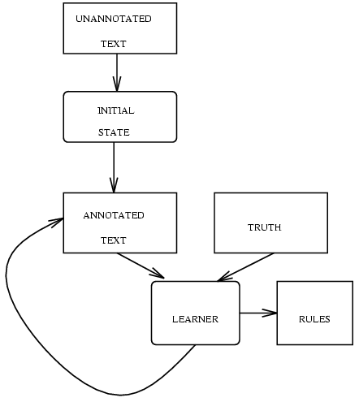
Brill Tagger: Transformation-based learning

Slide 52
procedure
Tag each word initially with most likely POS
Examine set of transformations to see which improves tagging decisions compared to truth
add the transformation that brings the highest improvement to the list of transformations learned so far and re-tag corpus using this transformation
Repeat until, e.g., performance doesn’t improve
Result: ordered list of transformations which can be applied to new, untagged text

Slide 53
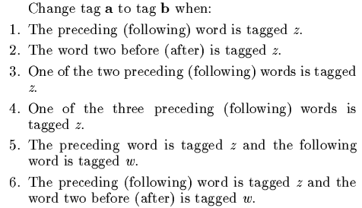
transformation space：92版

Slide 54
Rules larned 学到的规则举例
如果前面一个单词的词性为modal, 把当前词的词性从noun改为verb

Slide 55
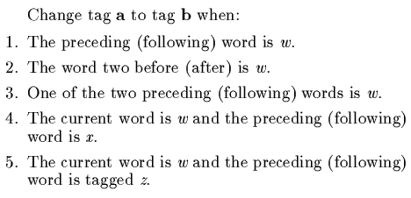
transformation space：94版
增加了基于词的变换：

Slide 56
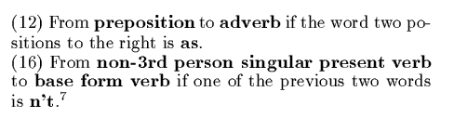
New rules learned
学到的新规则举例：
正确地处理了 as/adv tall/adj as/prep

Slide 57
Brill Tagger的特点
获取的规则比统计数据易懂
可以容易地增加新的变换，如允许检查语义类、词缀等
准确率高于HMM Tagger （他的实验）
学习速度应该比较慢（变换空间大），因为学到的规则只有几百条，运行速度应该是线性的
Brill Tagger以及许多公开的程序都是linux下的！

Slide 58
Word segmentation and character combination
分词和合字
把句子分成词，也可反过来看：把字合成词
Sequence labelling problem 序列标注问题
  我/S 是/S 一/S 个/S 老/B 师/E
  S B I E 分别表示单独成词、词头、词中、词尾
  这样把分词问题看作字的序列标注问题，可采用多种依赖复杂特征函数进行序列标注的机器学习算法解决（如ME, CRF）
  这种方法能较好地处理OOV，而且性能比分词算法有一定提高

Slide 59
Word Segmentation and Big data
分词与大数据
Word segmentation still not satisfactory for microblogs 分词在大规模网络文本上的性能仍然不佳
  微博分词
Prof. Maosong Sun: use naturally annotated data 孙茂松：利用自然标注

Slide 60
Deep learning and word segmentation
深度学习与分词
避免人工选取特征函数，采用深度学习的方法自动生成特征：把特征用词向量统一表示
Papers 有关论文
  Xiaoqing Zheng et al, Deep Learning for Chinese Word Segmentation and POS Tagging. 2013.
  Yoshiaki Kitagawa and Mamoru Komachi, Long Short-Term Memory for Japanese Word Segmentation. 2017
  Hassan Sajjad et al, Challenging Language-Dependent Segmentation for Arabic: An Application to Machine Translation and Part-of-Speech Tagging. 2017.

Slide 61
Homework
In Penn Tagset, the tag IN can represent either a preposition or a subjuntcive conjunction, and the tag TO can represent either infinitive marker to or preposition to, which I think is bizzare. Can you train a different tagger, e.g. by split IN into IN-prep and IN-conj? Is your new tagger better or worse in accuracy?

Slide 62
Projects课程设计
Develop a tagger for Ancient Chinese/Poems. 古汉语分词或唐诗分词系统。
Develop a POS tagger that can learn new words from the web everyday. 设计可以不断学习的分词程序，每天可从网上学习新词

